Slide 1


M.Tech/MCA Program
Advanced Industry Integrated Programs
Jointly offered by University and LTIMindTree
Review III
Rag Based Technical Knowledge, Maintenance
And Safety Support for power distribution employees
Team member:
Sammangi Gopi Chand
TID: T9929
College: Vellore Institute of Technology
Knowledge partner | Implementation partner

Slide 2
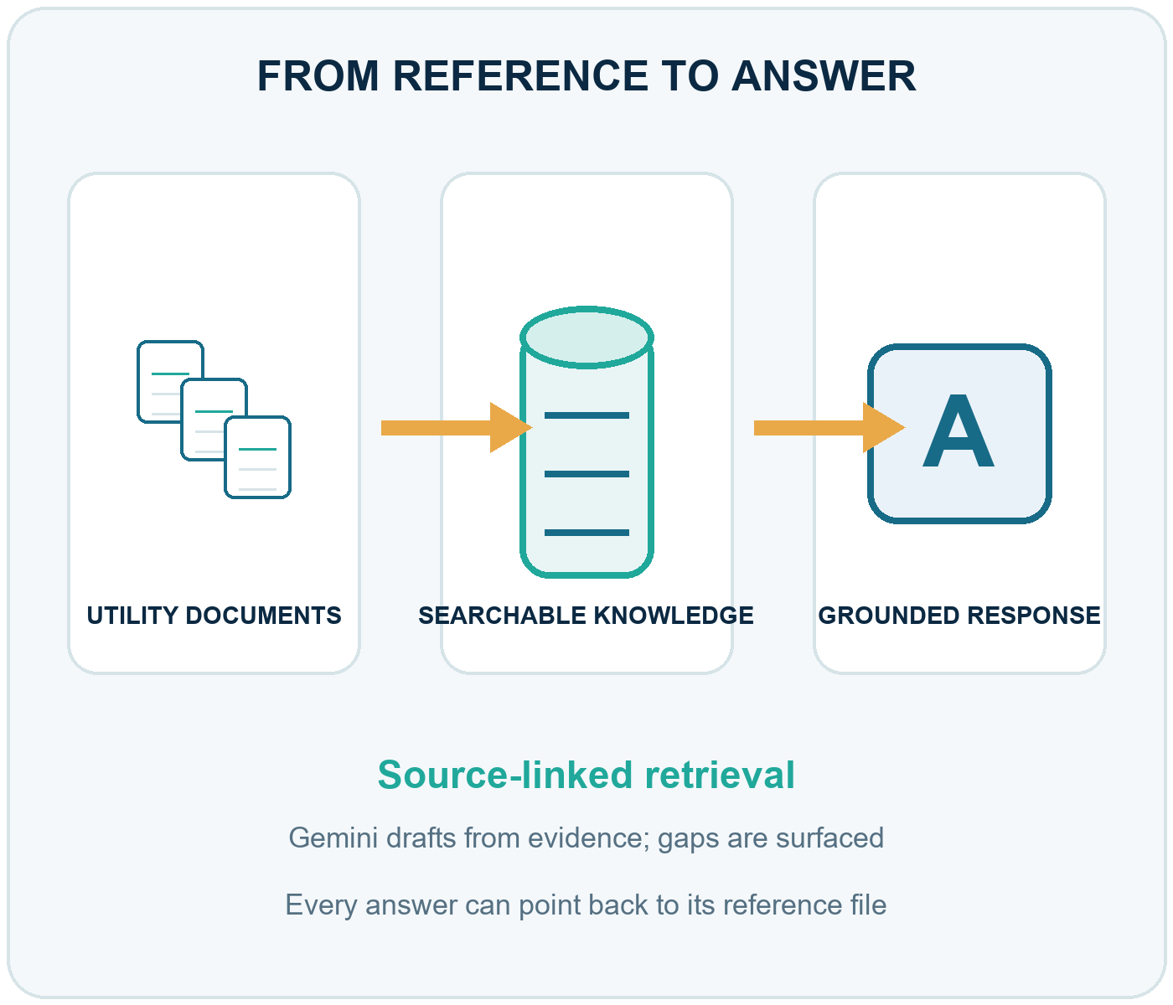
Utility Employee RAG | Review III
Introduction
Utility teams depend on technical, regulatory and safety guidance spread across documents.
The application indexes the supplied corpus and retrieves relevant passages for employee questions.
Gemini drafts answers from retrieved context, shows source filenames and flags evidence gaps.
Employees create source-referenced work checklists and record step completion.

Slide 3
Utility Employee RAG | Review III
Project Objectives
Build a searchable knowledge base from supplied utility documents.
Retrieve relevant passages to support employee questions with source traceability.
Generate concise answers only from retrieved context and identify information gaps.
Create ordered work-process checklists with supported prerequisites, safety notes and references.
Let employees record progress and administrators review employee activity and refresh the index.

Slide 4
Utility Employee RAG | Review III
Application Modules
Employee portal: knowledge assistant, saved checklists and step completion tracking.
Document pipeline: PDF, DOCX, TXT and CSV extraction, chunking, embeddings and indexing.
RAG assistant: similarity search, context-grounded answers and source filenames.
Work-process generator: ordered worksheets with source references for every step.
Admin portal: employee overview, account controls and background re-indexing.

Slide 5
Utility Employee RAG | Review III
Problem Statement
Utility guidance is distributed across multiple technical and safety documents.
Finding the relevant passage manually can slow access to work instructions.
Answers and generated procedures need traceable sources and must not fill document gaps with guesses.
Work-step completion also needs a persistent record for employees and an administrative overview.

Slide 6
Utility Employee RAG | Review III
Methodology
Utility documents are indexed, retrieved as context, and used for source-backed answers and tracked checklists.
Load sources
Read PDF, DOCX, TXT and CSV reference files.
→
Prepare text
Extract text and split into 300-word chunks with 50-word overlap.
→
Build index
Embed with all-MiniLM-L6-v2 and index in FAISS.
→
Retrieve context
Q&A uses 5 passages; checklists search 30 and use up to 10.
→
Answer & track
Ground Gemini output in sources; save checklist progress.

Slide 7
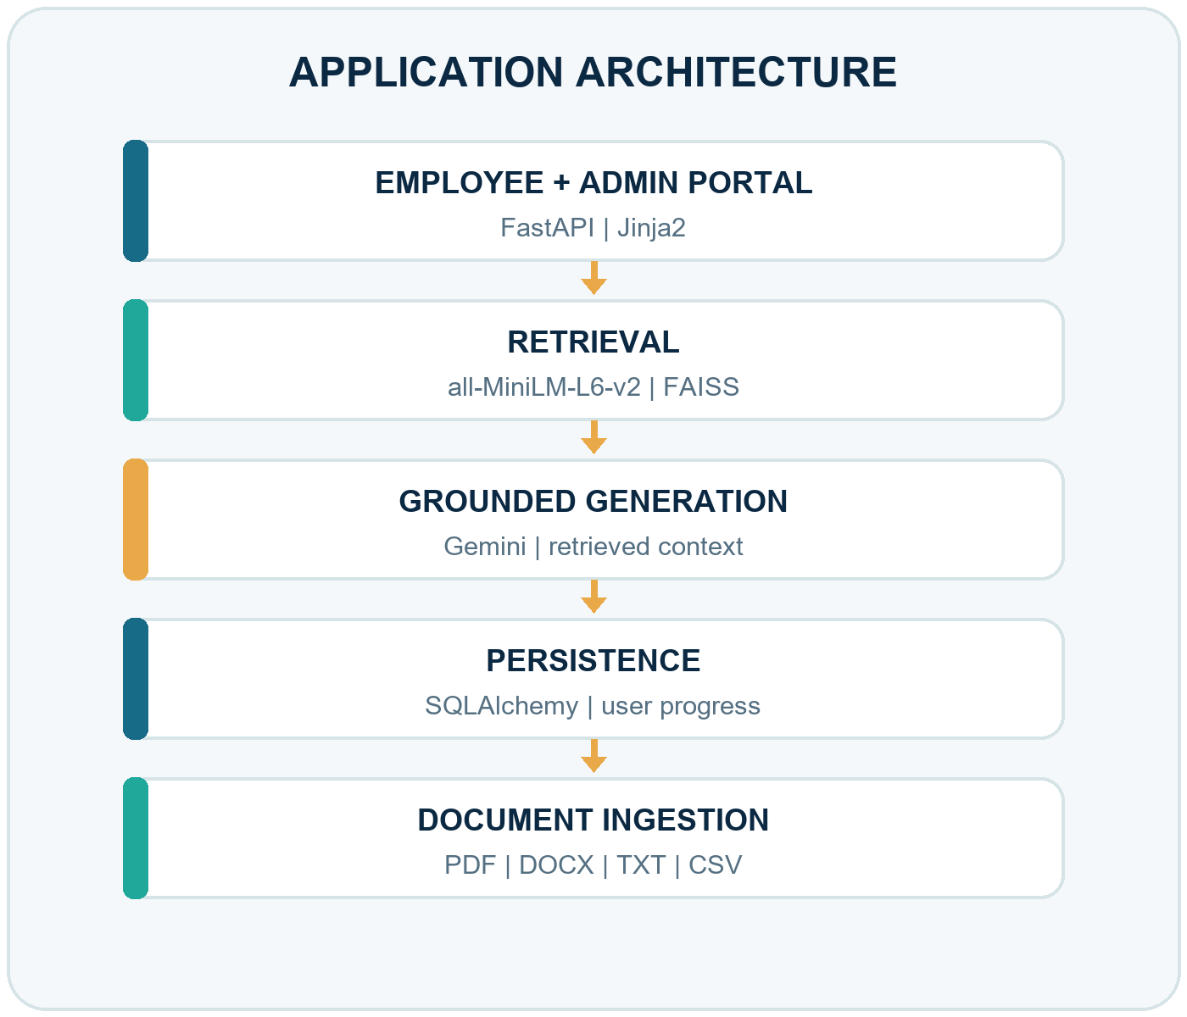
Utility Employee RAG | Review III
Approach, Algorithms and Tools
Web: FastAPI with Jinja2 employee and administrator interfaces.
Retrieval: all-MiniLM-L6-v2 embeddings with FAISS inner-product search.
Generation: Gemini answers are constrained to retrieved context.
Persistence: SQLAlchemy stores users, checklists, steps and progress.
Ingestion: PDF, DOCX, TXT and CSV; 300-word chunks, 50-word overlap.

Slide 8
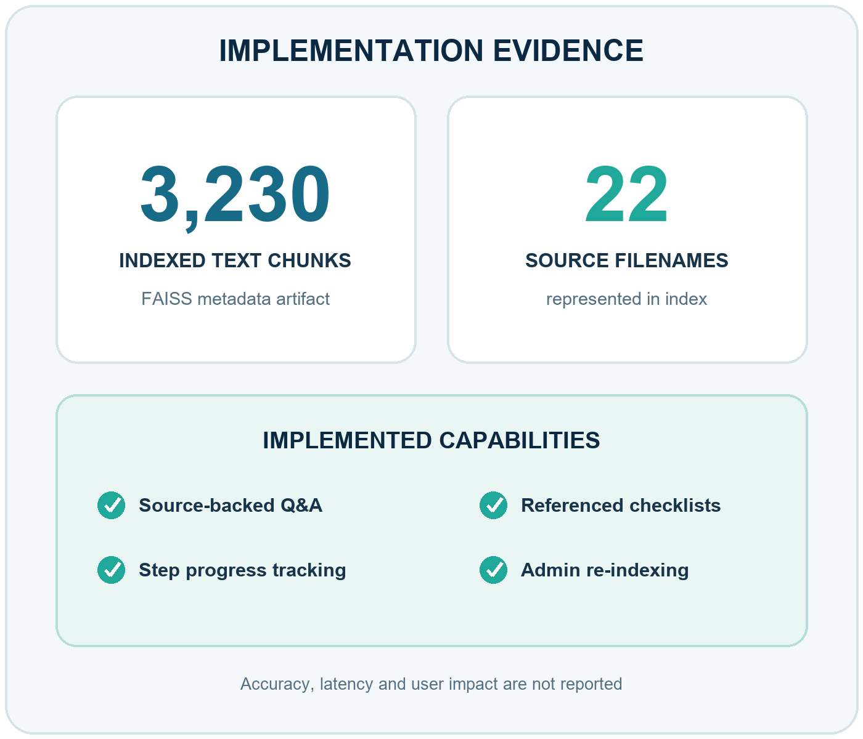
Utility Employee RAG | Review III
Findings and Results
Corpus artifact: 3,230 indexed text chunks across 22 source filenames.
Implemented: employee Q&A, referenced checklists, step tracking and administrator re-indexing.
Checklist validation enforces consecutive numbering and a source for every step; evaluation metrics are not reported.

Slide 9
Utility Employee RAG | Review III
Conclusion
The codebase brings document retrieval, grounded employee Q&A and work-process tracking into one application.
Source references and explicit insufficient-information handling support traceability in generated guidance.
The bundled index provides a concrete corpus artifact: 3,230 chunks across 22 source filenames.

Slide 10
Utility Employee RAG | Review III
Acknowledgement
The template identifies the program as jointly offered by the VIT University and LTIMindTree.

Slide 11
Utility Employee RAG | Review III
References
Lewis, P., Perez, E., Piktus, A., et al. (2020). “Retrieval-Augmented Generation for Knowledge-Intensive NLP Tasks.” NeurIPS 2020.
Karpukhin, V., Oguz, B., Min, S., et al. (2020). “Dense Passage Retrieval for Open-Domain Question Answering.” EMNLP 2020, pp. 6769–6781.
Reimers, N., and Gurevych, I. (2019). “Sentence-BERT: Sentence Embeddings using Siamese BERT-Networks.” EMNLP-IJCNLP 2019, pp. 3982–3992.
Johnson, J., Douze, M., and Jégou, H. (2017). “Billion-scale Similarity Search with GPUs.”
Es, S., James, J., Espinosa Anke, L., and Schockaert, S. (2024). “RAGAs: Automated Evaluation of Retrieval Augmented Generation.” EACL 2024, pp. 150–158.
Wang, W., Wei, F., Dong, L., Bao, H., Yang, N., and Zhou, M. (2020). “MiniLM: Deep Self-Attention Distillation for Task-Agnostic Compression of Pre-Trained Transformers.” NeurIPS 2020.

